Slide 1
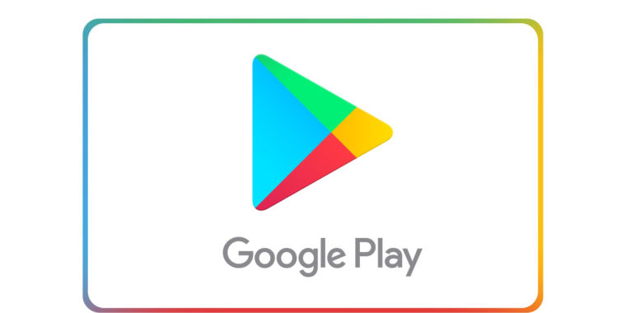
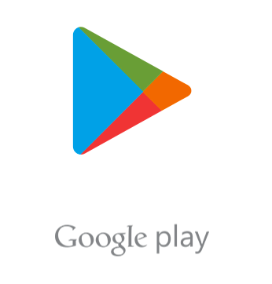
Capstone Project
Play Store App Review Analysis
BY
Rishabh Patidar

Slide 2
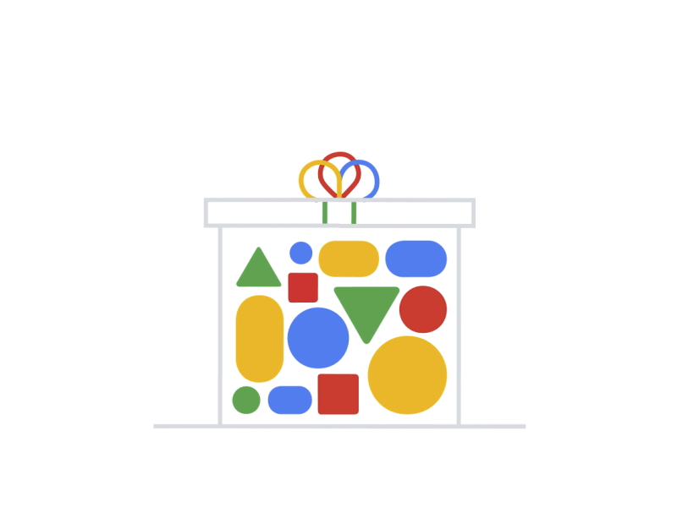
Content
Problem Statement / Description
The Goal Of This Project
Introduction
Data preparation & cleaning
EDA
Conclusion

Slide 3
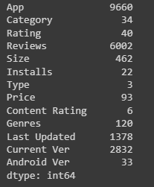

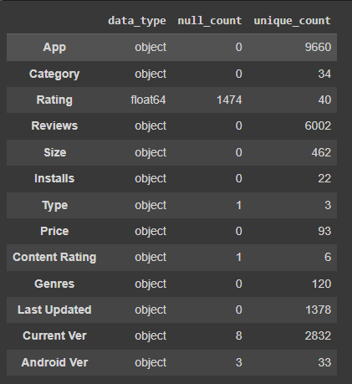

Problem Statement / Description
Android has become the most popular operating system in the world. It has captured around 74% of the total market, a true indicator of how popular Android is with users. Our goal is to help developers understand what factors motivate people to download apps from Google Play. We would like to analyze categories, reviews, price and ratings for this purpose and find out how they are interrelated.
Dataset: The dataset consists of 13 columns:- App, Category, Rating, Reviews, Size, Installs, Type, Price, Content Rating, Genres, Last Updated, Current Ver, and Android Ver with 10841 Rows.

Slide 4


The Goal Of This Project
The goal of this project is to deliver insights that help app developers better understand customer demands and thus popularize their products. Our objective is to explain how certain factors affect customer behavior and thus provide information that can help developers identify what consumers want and need in order for them to make the best purchase decision.

Slide 5


Introduction
The number of apps available on Google Play Store is greater than 3.04 million. In this project/article, we will go through a journey of analyzing various apps found on the play store with the help of different Python libraries.
The dataset contains details of Android applications present on the Google Play Store. For analysis, we have used Python. Our business case is to locate the best Apps, which we measure by review check. The dataset contains 13 records that depict each application and an aggregate of 10842 applications.

Slide 6
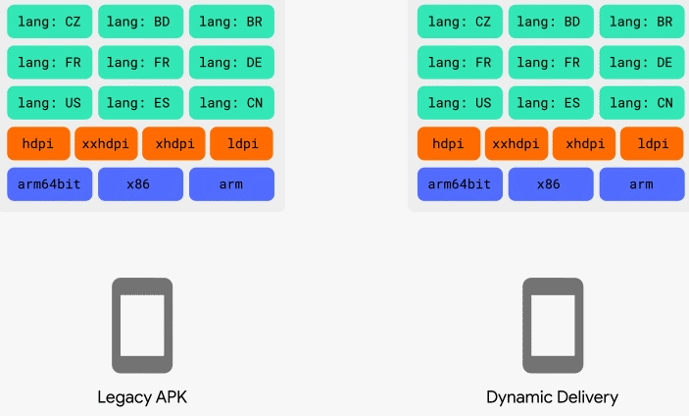
Data Preparation and Cleaning
Data preparation is the process of cleaning and transforming raw data prior to processing and analysis. It is an important step prior to processing and often involves reformatting data, making corrections to data and the combining of data sets to enrich data. Data cleansing or data cleaning is the process of detecting and correcting (or removing) corrupt or inaccurate records from a record set, table, or database and refers to identifying incomplete, incorrect, inaccurate or irrelevant parts of the data and then replacing, modifying, or deleting the dirty or coarse data.
First, we identified which data columns are irrelevant to the number of installs of an app. I removed the size and last updated date because they are not related to the number of downloads before publishing. We also removed ratings and reviews because they are obviously related to app installs and would not be known before publishing. Next, we trimmed our data of any out-of-place characters.
Note: In this section Data Preparation and Cleaning. see that the original dataset contains 10841 Rows and 13 Columns. It contained App, Category, Rating, Reviews, Size, Installs, Type, Price, Content Rating, Genres, Last Updated, Current Ver, and Android Ver Columns. But after cleansing the dataset and droping the unwanted rows and columns having Null Values and Garbage data from the database, we are left with 8434 Rows and 10 Columns.

Slide 7
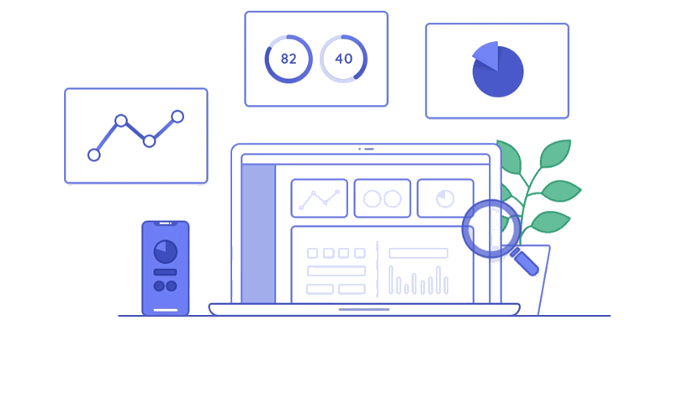
Exploratory Data Analysis

Slide 8

EDA (cont……)
Exploratory data analysis is an approach to analyzing data sets to summarize their main characteristics, often with visual methods. A statistical model can be used or not, but primarily EDA is for seeing what the data can tell us beyond the formal modeling or hypothesis testing task. Data visualization is the graphic representation of data. It involves producing images that communicate relationships among the represented data to viewers of the images. This communication is achieved through the use of a systematic mapping between graphic marks and data values in the creation of the visualization. This mapping establishes how data values will be represented visually, determining how and to what extent a property of a graphic mark, such as size or color, will change to reflect changes in the value of a datum.
e

Slide 9
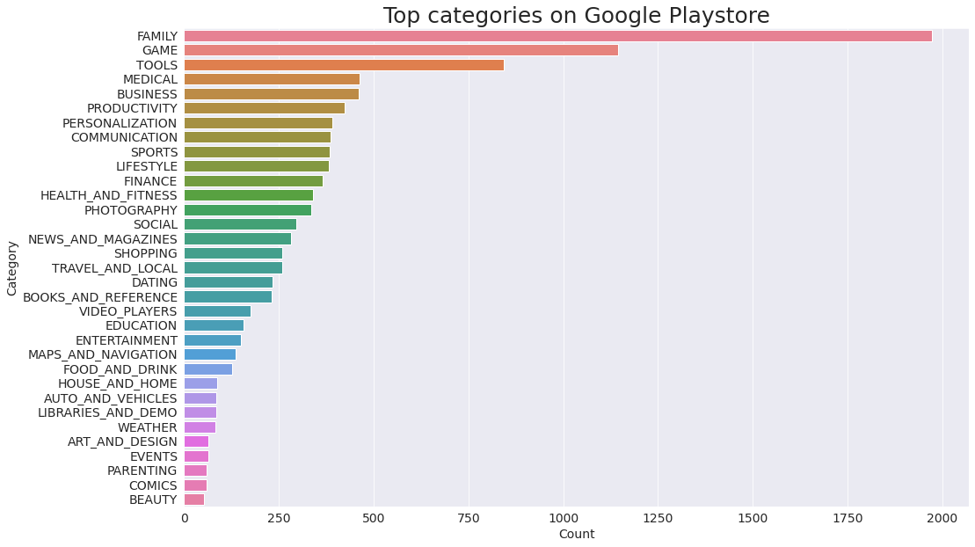

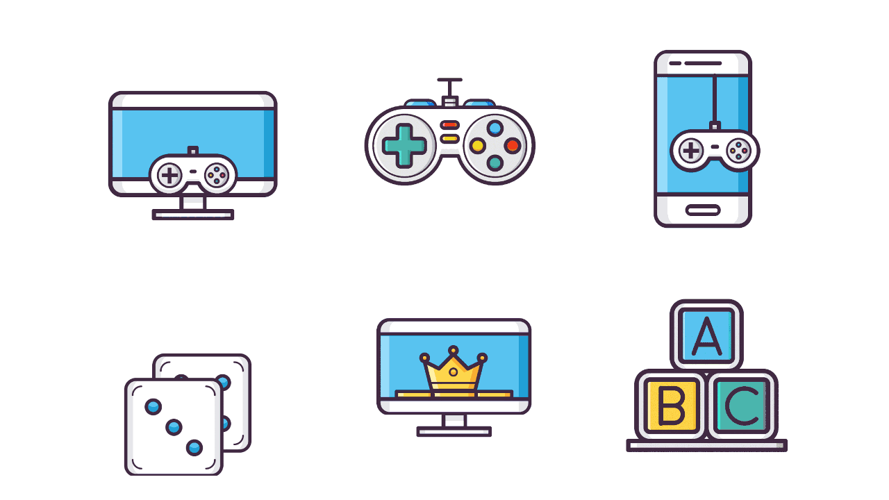
Top categories on Google Playstore
In the dataset, there are 33 categories. From the above output we can conclude that in playstore most of the apps are under Family & Game category and least are of Beauty & Comics Category

Slide 10
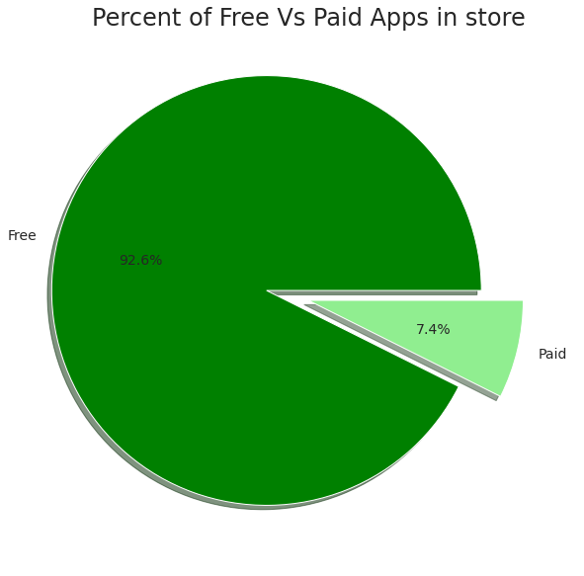
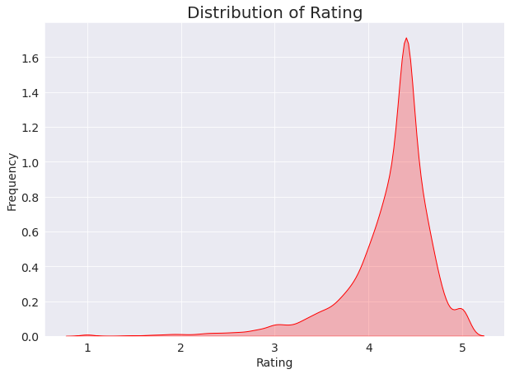
Free VS Paid app
Distribution of Rating
The above graph shows the percentage of free and paid apps in Google Play store. We can see that 92% (approx.) of all apps in Google Play store are free, and 8% (approx.) are paid.
We can see from the above graph that most of the apps in Google Play are rated between 3.5 and 4.8. This is not a coincidence, as this shows that the developers understand the importance of rating their apps according to their quality, rather than just focusing on the number of downloads they get.

Slide 11
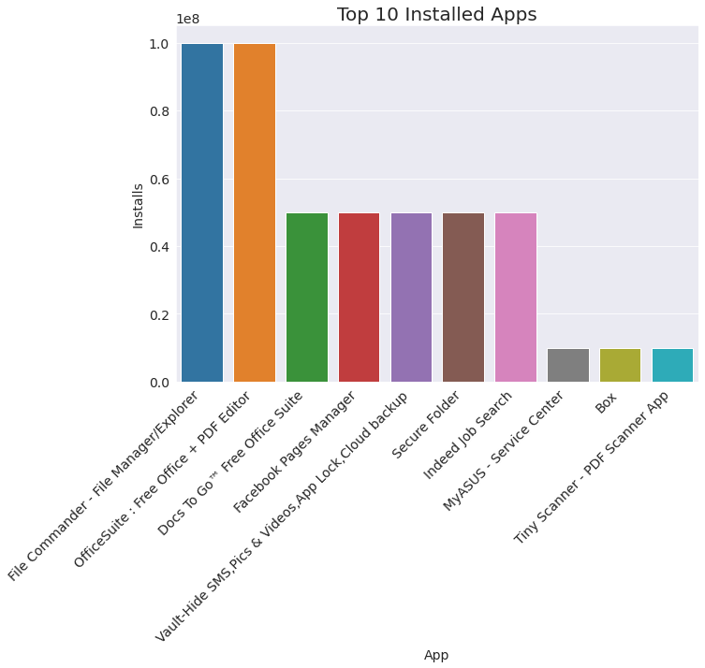

Top 10 installed apps
Here we can see that in the Business category, OfficeSuite has the highest number of installs. In the same way by passing different category names to the function, we can get the top 10 installed apps.

Slide 12
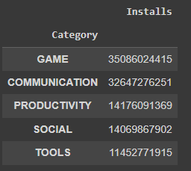
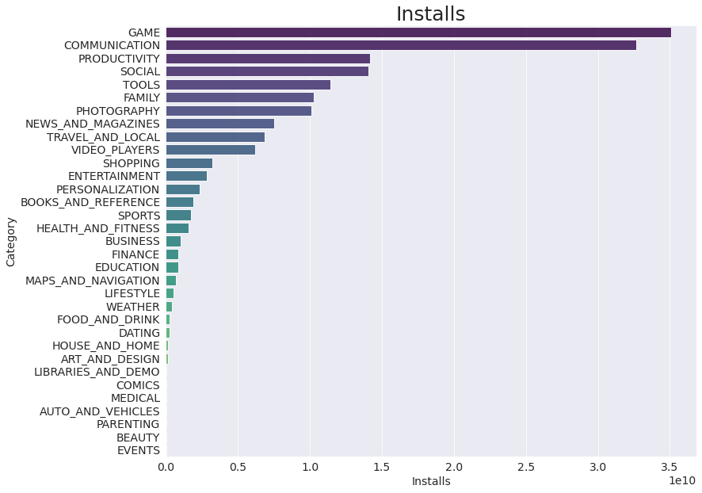
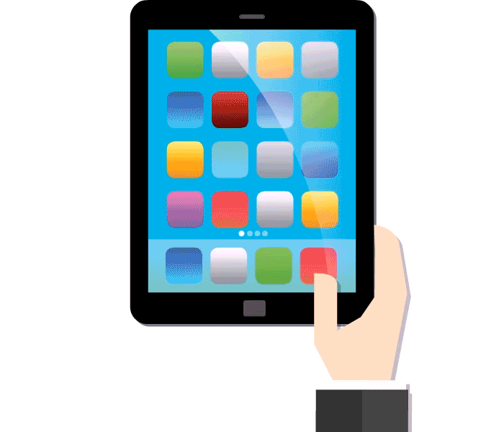
App's have most number of installs
Based on the data in the above visualization, it can be interpreted that the top categories with highest installs are Game, Family, Communication, News & Magazines, & Tools.

Slide 13
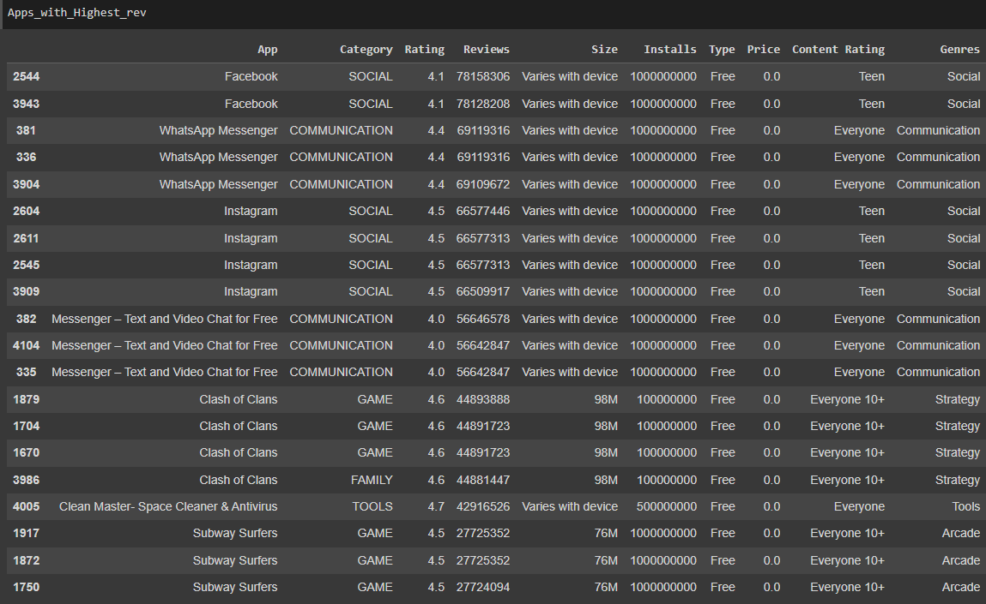
Apps with highest number of reviews
The data in the following table gives an indication of the number of reviews each app has on Google Playstore. We can interpret this data and come to the conclusion that Clash of Clans, Subway Surfers, Clash Royale, and Candy Crush Saga have the highest number of reviews on Google Playstore.

Slide 14
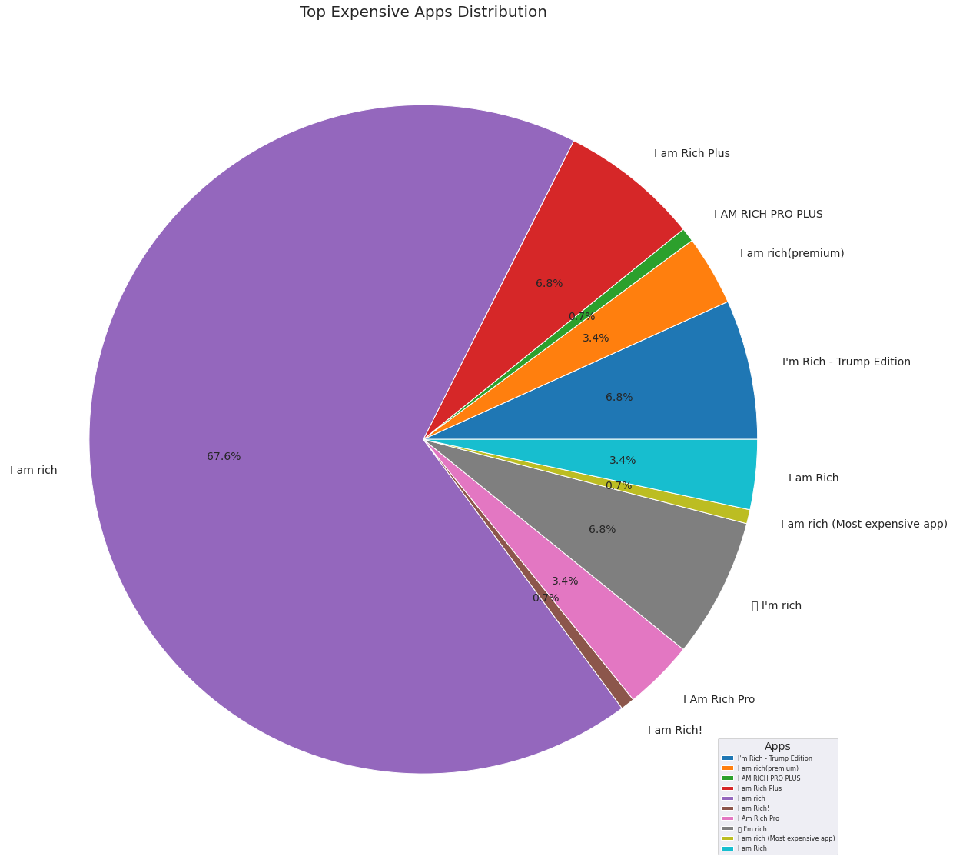

Top Expensive Apps
This is a visualization of the most expensive apps on the Google Playstore. We can see that the app I am rich is the most expensive, followed by I am Rich Premium. We also had to drop one row of data for this visualization because the language of the app was Chinese and it was messing with the pie chart.

Slide 15
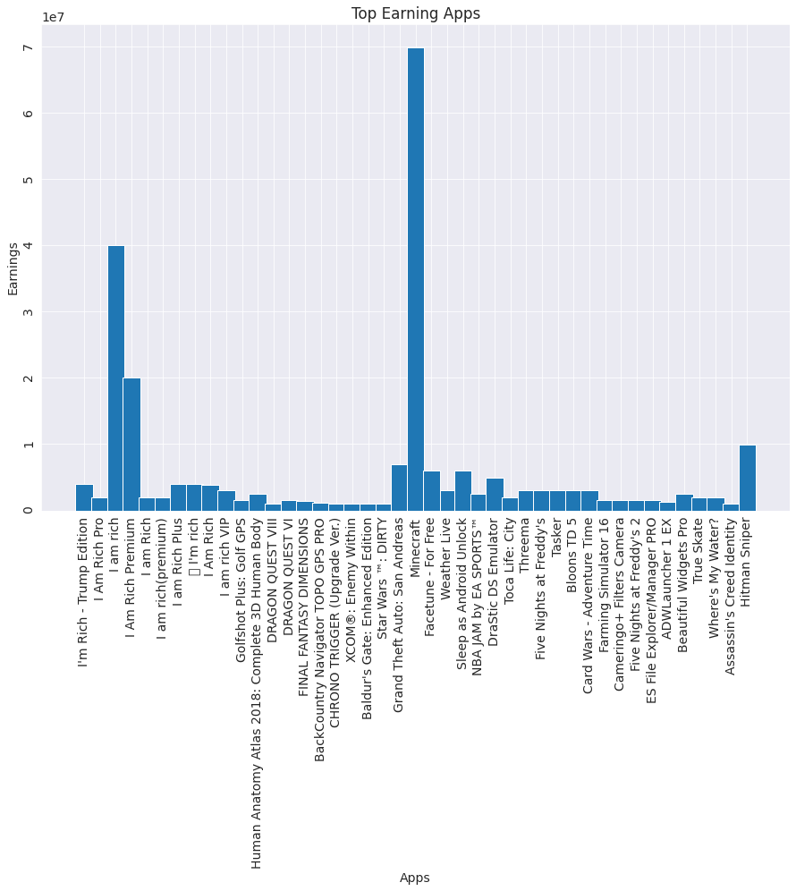

Top Earning Apps
In this presentation, we will discuss the top five apps with the highest earnings found on the google play store. These apps are:
I am Rich
I am Rich Premium
Hitman Sniper
Grand Theft Auto: San Andreas
Facetune - For Free

Slide 16
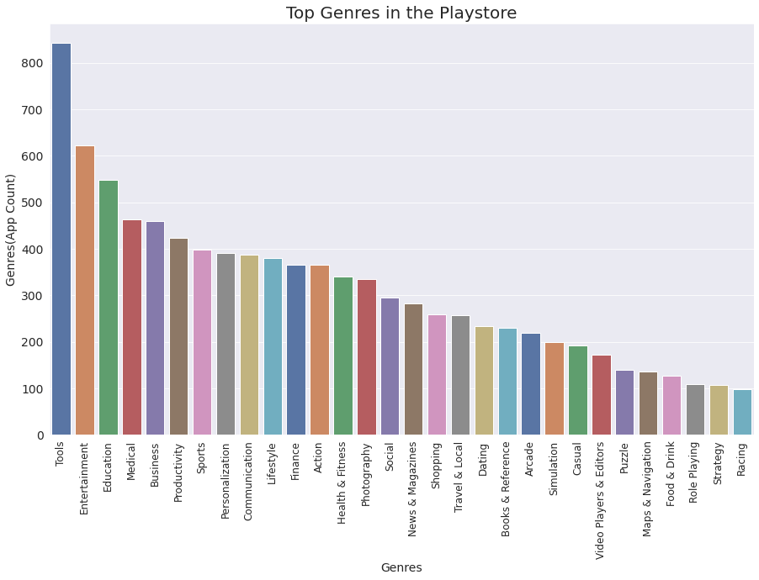

Top Genres in the Playstore
The data visualization above shows how popular the different categories of apps are among users. The highest numbers are found in the Tools and Entertainment genres, followed by Education, Medical, and many more.

Slide 17

Conclusion
I have learned and gotten exposure to different tools and techniques in data analysis. I was able to complete the project successfully with the help of tools like Python, Pandas, Matplotlib, Numpy, Seaborn, and Jovian. Also, I learned different techniques like Data Cleaning, Data Preparation, Data Exploration and visualization, and Data Interpretation.
The dataset provided in this project is a set of data that contains ratings from users and the app they installed. The dataset can be used to deliver insights to understand customer demands better, which is the goal of this project. The dataset can also be used to look at whether the original ratings of the app match the predicted rating to know whether the app is performing better or worse compared to other apps on the Play Store. It is not limited to the problem taken into consideration for this project. Many other interesting possibilities can be explored using this dataset.
Future Work :- The future work is to predict the number of reviews and installs by using the regression model. This will be done through a Machine Learning approach.The model will be trained with a set of historical data and then tested on new data. The model will be able to predict the number of reviews and installs based on various factors such as:- App categories- App size- Version of AndroidThe model can also be used to identify the category and stats of the most installed apps. It can also be used to explore the correlation between these factors on the number of installs.

Slide 18

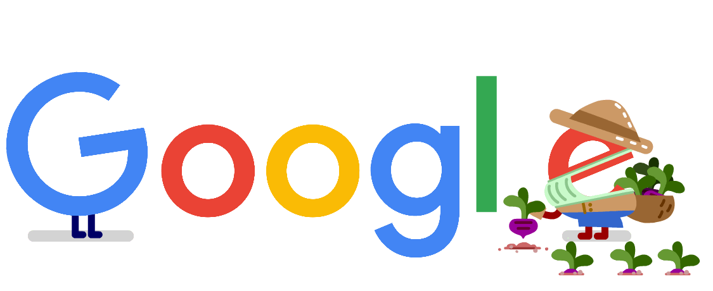


Slide 19


